Slide 1

SleepSense
Leveraging Artificial Neural Networks for Stress Detection and Prediction
By
Shakthi Balasubramanian (Team 3)

Slide 2
Table Of Contents
Introduction
Problem Statement
Objectives
Methodology
Data Collection
Data Preprocessing
Model Selection
Implementation
Results and Evaluation
Conclusion

Slide 3

Introduction
What is Stress?
Stress is a physical, mental, or emotional response to external pressures or challenges, often impacting overall well-being and performance.
Chronic stress can lead to severe health problems, such as cardiovascular diseases, mental health disorders, and immune system suppression.

Slide 4

Introduction
Challenges in Stress Detection
Traditional stress assessment relies on self-reported surveys, which are subjective and may lack real-time accuracy.
Artificial Neural Networks (ANNs), particularly, are powerful in handling complex datasets, learning from non-linear relationships, and making accurate predictions based on physiological markers.

Slide 5

Problem Statement
The Need for Real-Time, Objective, and Accessible Stress Detection
With the advancements in wearable technology and biosensors, physiological data like heart rate, EEG, and respiratory rate are readily available. However, efficiently interpreting this data to accurately detect stress in real-time remains a challenge.

Slide 6

Problem Statement
Objective of the Project
Goal: Develop a machine learning model capable of detecting stress based on physiological data inputs through the application of an Artificial Neural Network (ANN).
Outcome: A web application accessible from wearable data inputs, aiming to enhance self-awareness, timely intervention, and overall well-being.

Slide 7



PROJECT OVERVIEW
CREATE A NEW USER ACCOUNT to access the stress detection application.
LOGIN WITH YOUR USERNAME AND PASSWORD to secure your personalized dashboard.
INPUT HEALTH DATA including Snoring Rate, Respiratory Rate, Body Temperature, Limb Movement, and more.
RECEIVE STRESS PREDICTION RESULTS generated by the Artificial Neural Network (ANN) model to monitor and manage stress levels.
VIEW PAST PREDICTIONS and health data, providing insights into your stress patterns over time.

Slide 8
Objectives
Develop an Accurate Stress Detection Model : Use machine learning, specifically an Artificial Neural Network (ANN), to create a reliable model that can predict stress levels based on physiological data inputs.
Outcome: A model that accurately classifies stress as either present or absent, based on various bio-signals.
Integrate Real-Time Physiological Data Inputs : Collect and process data from multiple sources like heart rate, EEG, respiratory rate, and other physiological metrics to monitor stress levels dynamically.
Outcome: A comprehensive dataset and data pipeline that supports real-time stress detection.

Slide 9
Objectives
3. Build a User-Friendly Web Application : Design a web interface that allows users to access their stress levels in real-time, providing insights and trends over time.
Outcome: A fully functional, accessible web application where users can view and interpret their stress data in a user-centric manner.
4. Contribute to Future Research and Development : Share findings and insights from the project that could support further advancements in stress detection and mental health monitoring.
Outcome: A foundation for future studies on stress prediction, wearable technology, and mental health interventions.

Slide 10
PROJECT MILESTONES
Milestone 01: Data Preprocessing
Milestone 02: ANN Model Design
Milestone 03: Model Training and Visualization
Milestone 04: Model Deployment
Data Cleaning and Preparation: Preprocessed and cleaned the data to ensure accurate analysis.
Model Structure: Designed the ANN model with specific layers tailored to the input parameters, enabling precise stress level predictions.
Training: Trained the model on the dataset, optimizing hyperparameters.
Integration: Deployed the ANN model within the Django application.
Visualizations: Utilized tools like bar charts, correlation matrices, and pair plots to explore relationships among variables.
Performance Metrics: Visualized the training process using metrics such as accuracy and loss to monitor model performance.
User Experience: Ensured a seamless user experience where predictions are generated in real-time based on user inputs.

Slide 11

Methodology
Data Collection
Sources: Physiological data, which includes heart rate, body movements, respiratory rate, EEG data, sleep patterns, blood oxygen levels, snoring rate, and limb movement rate.
Ensure diverse, high-quality data that represents both stressed and non-stressed instances to improve the model’s generalizability.

Slide 12
Methodology
Data Preprocessing
Label Encoding: Convert the binary stress labels into numerical format for model training (e.g., stressed = 1, not stressed = 0).
Data Splitting: Divide the data into training, validation, and test sets to validate the model’s accuracy and generalization capabilities effectively.

Slide 13
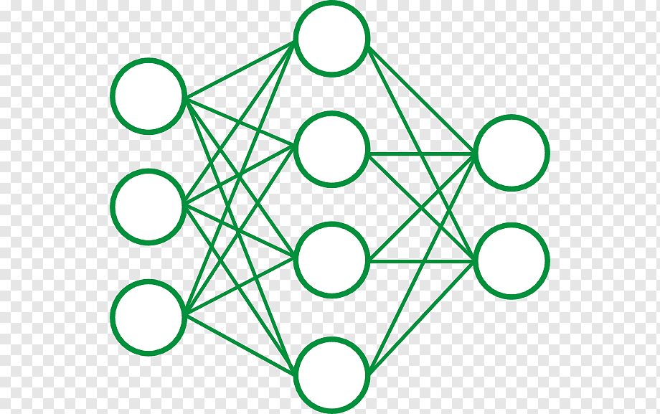
Methodology
Model Architecture:
Input Layer: Accepts multiple features related to physiological parameters.
Hidden Layers: Configured with neurons and layers to capture underlying patterns without overfitting.
Output Layer: A single neuron with sigmoid activation for binary classification.

Slide 14
ANN Model Design
Input Layer:
Accepts 8 numerical features derived from sleep data: Heart Rate, Body Movements, Respiratory Rate, EEG Data, Sleeping Hours, Blood Oxygen Level, Snoring Rate, and Limb Movement Rate.
Hidden Layers:
> 64 neurons with ReLU activation function for capturing complex patterns and relationships in the input data.
> 32 neurons with ReLU activation, reducing the feature space while retaining significant patterns.
Output Layer:
> A single neuron with a sigmoid activation function, designed for binary classification, outputting a probability of being stressed or not stressed.

Slide 15

Implementation
Django Framework Setup: Django was selected for its simplicity and scalability. The project structure includes an app for stress detection and organized templates for frontend design.
Backend and Model Deployment: The ANN model, saved in .h5 format, is loaded into Django using TensorFlow/Keras. User inputs are processed, and the model predicts stress levels in real-time.
Frontend Development: A user-friendly interface lets users enter physiological data (heart rate, sleep hours, etc.). CSS and JavaScript enhance form validation and results display.
Deployment: Tested locally and ready for hosting on platforms like Heroku or AWS, making real-time predictions accessible from a web browser.
Key Features: The Django site offers real-time predictions, an intuitive interface, and scalability for future enhancements like tracking and user registration.

Slide 16
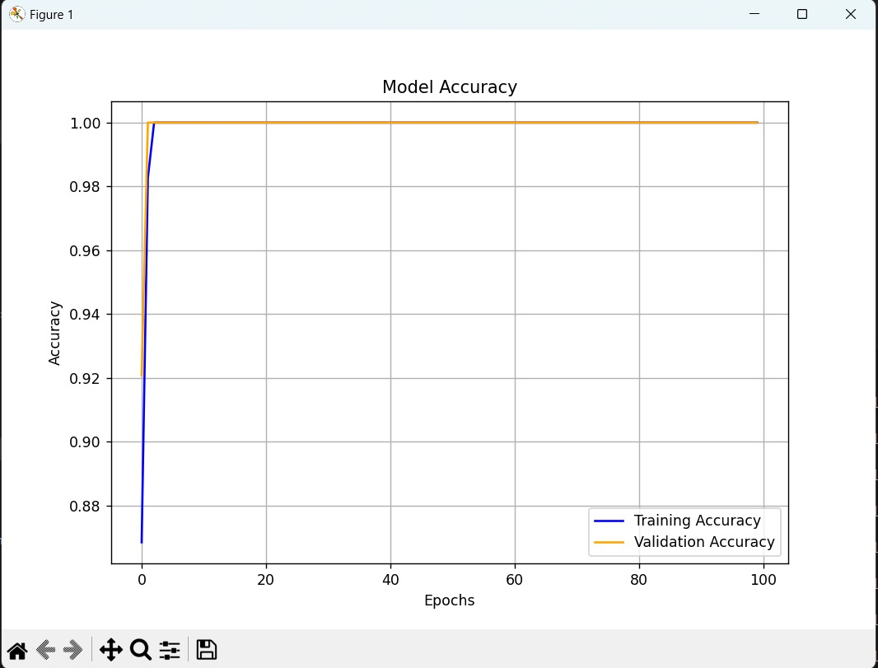
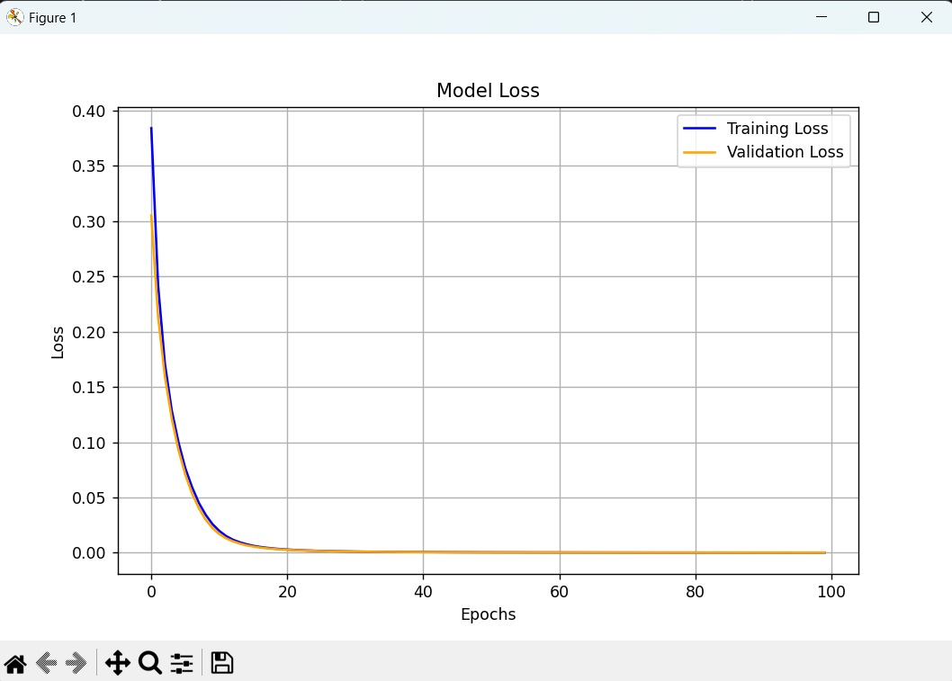
Model Training & Visualization
The ANN model was trained using a dataset of sleep-related physiological parameters for binary stress detection. It achieved a 100% test accuracy, demonstrating its effectiveness in identifying stress levels based on input features.

Slide 17


Slide 18
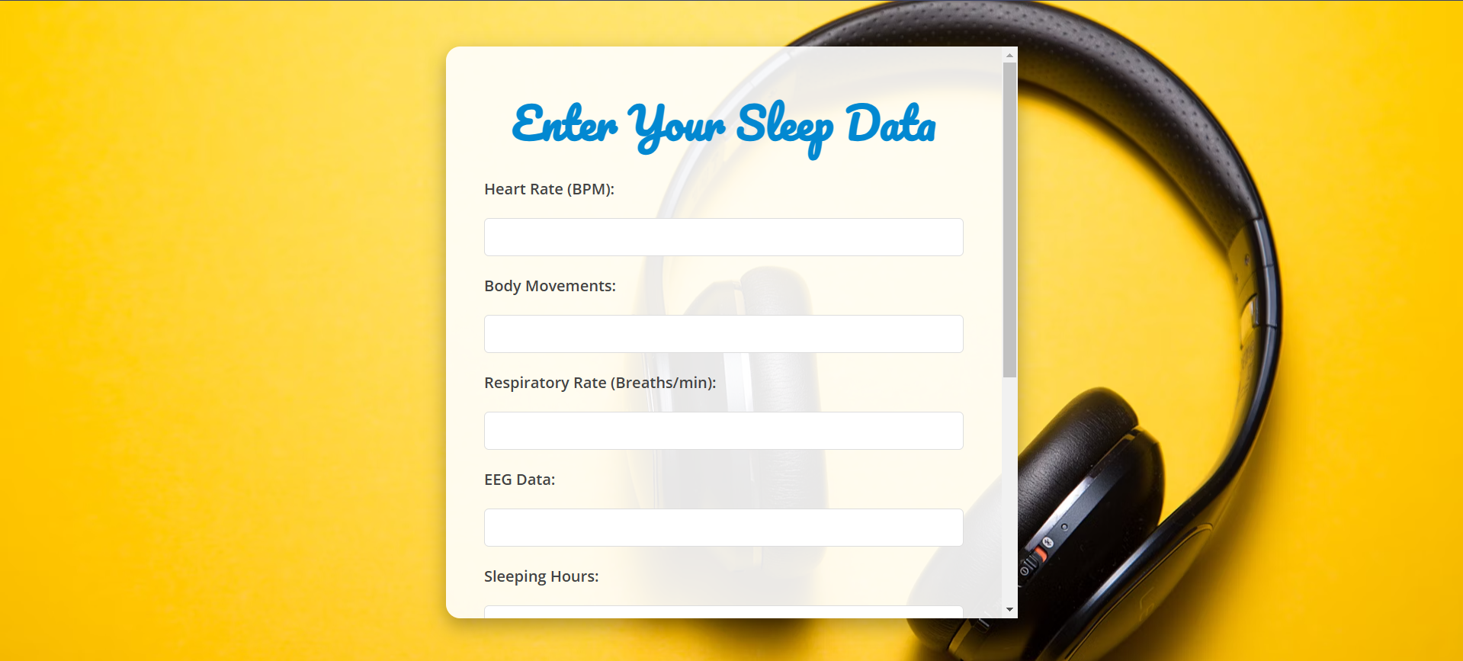

Slide 19


Depending on the input values, the model classifies as stressed/not stressed

Slide 20

Results
The ANN model achieved a decent accuracy in predicting stress levels which can be improved with further training, validating its reliability for real-time applications. It identified stress patterns across varied test cases, demonstrating stable performance and prediction consistency.
The Django web application further enhances accessibility by providing a user-friendly platform where users can input data and instantly receive stress predictions, making the solution both practical and easy to use.

Slide 21

Conclusion
This project successfully integrates machine learning with a web-based interface, allowing users to gain insights into their stress levels through easily accessible technology. The project highlights the power of predictive modeling in health monitoring, and with further improvements, this system could help individuals manage and understand stress in daily life.

